Slide 1

MSP partnership
Operational appendix
Service design, mobilisation and partner due diligence
Companion to the MSP partner briefing / Version 11 / October 2026
01
Notes:
RouterStack operational briefing, October 2026. Confirm scope, availability and service commitments per contract. Images are generated illustrations, not customer engagement photographs.

Slide 2
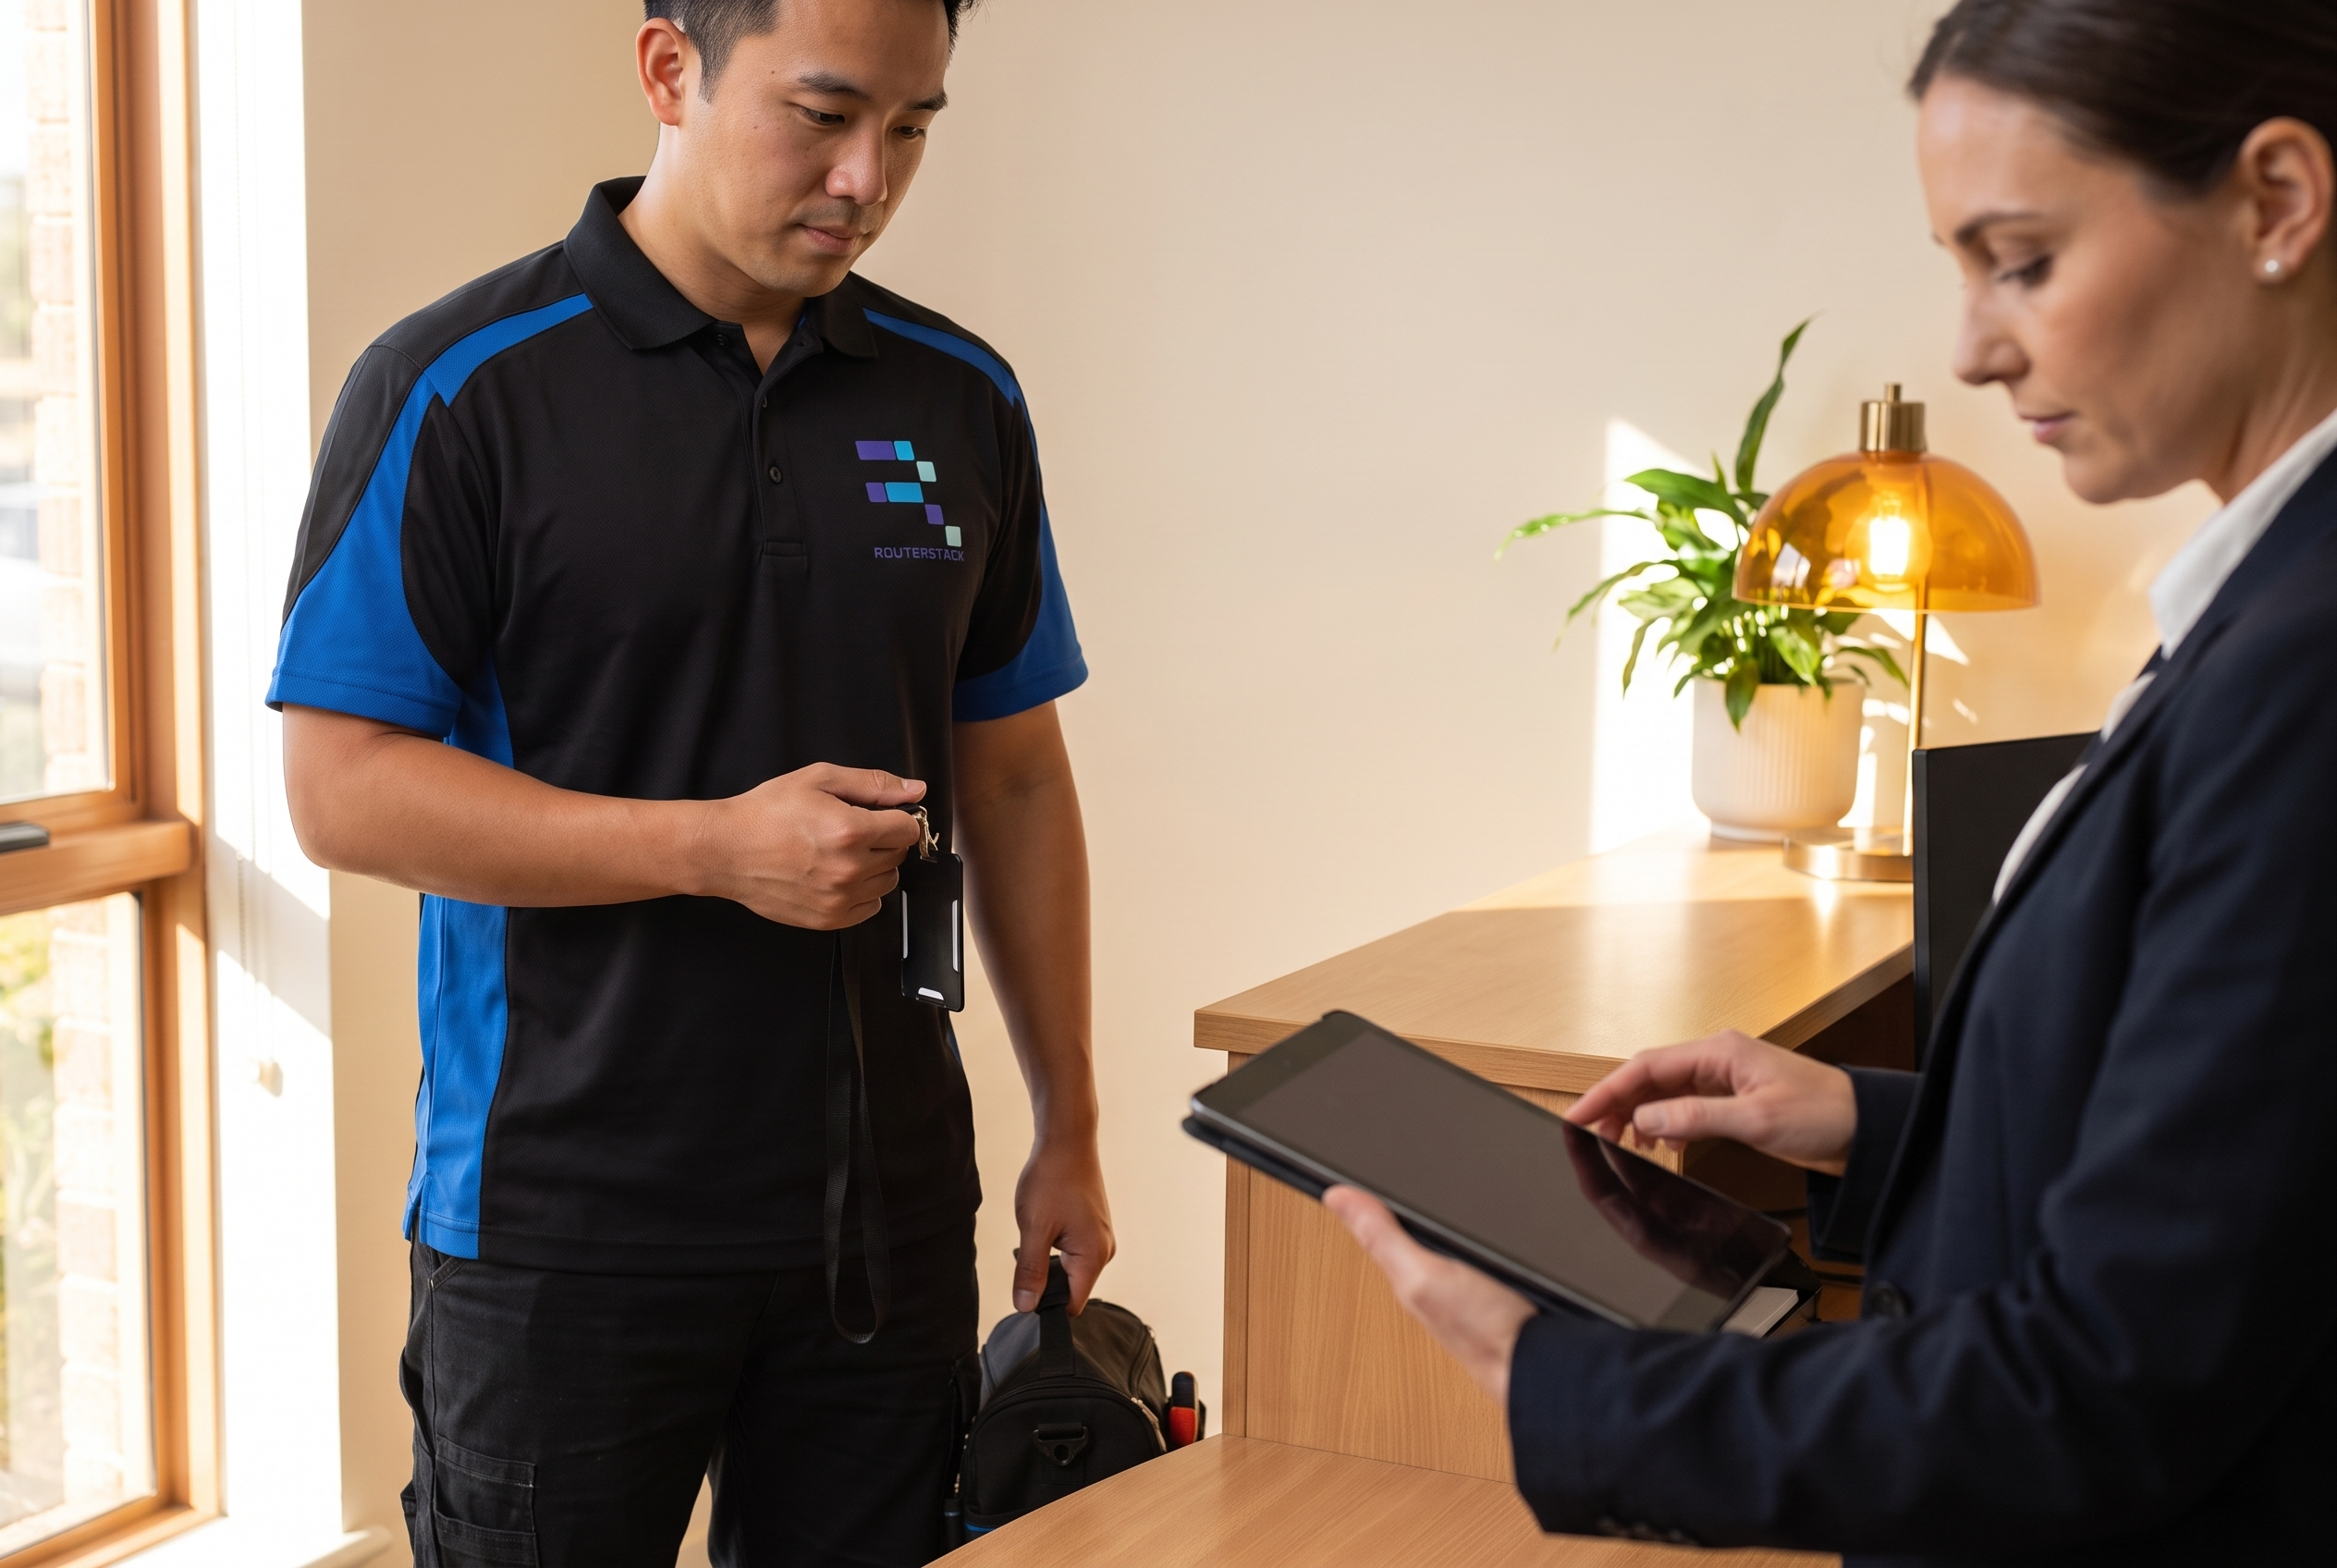
Coverage and capacity planning
Main metropolitan areas
Typically several technicians to support scheduling and backup
Regional locations
Some locations have one technician and may require travel
New coverage requirements
Allow for recruitment and onboarding before committing to a site SLA
02
Notes:
RouterStack operational briefing, October 2026. Confirm scope, availability and service commitments per contract. Images are generated illustrations, not customer engagement photographs. Reference-guided RouterStack service illustration using supplied technician profile and uniform assets.

Slide 3

Technical scope and authority
Broad field capability
Level 1 and Level 2 support, audits and basic troubleshooting
Work under your direction
Configuration and data-handling tasks require agreed authority and controls
Specialist scope review
Level 3 depends on location. Electrical, fibre and structured cabling need separate review
03
Notes:
RouterStack operational briefing, October 2026. Confirm scope, availability and service commitments per contract. Images are generated illustrations, not customer engagement photographs. Reference-guided RouterStack service illustration using supplied technician profile and uniform assets.

Slide 4
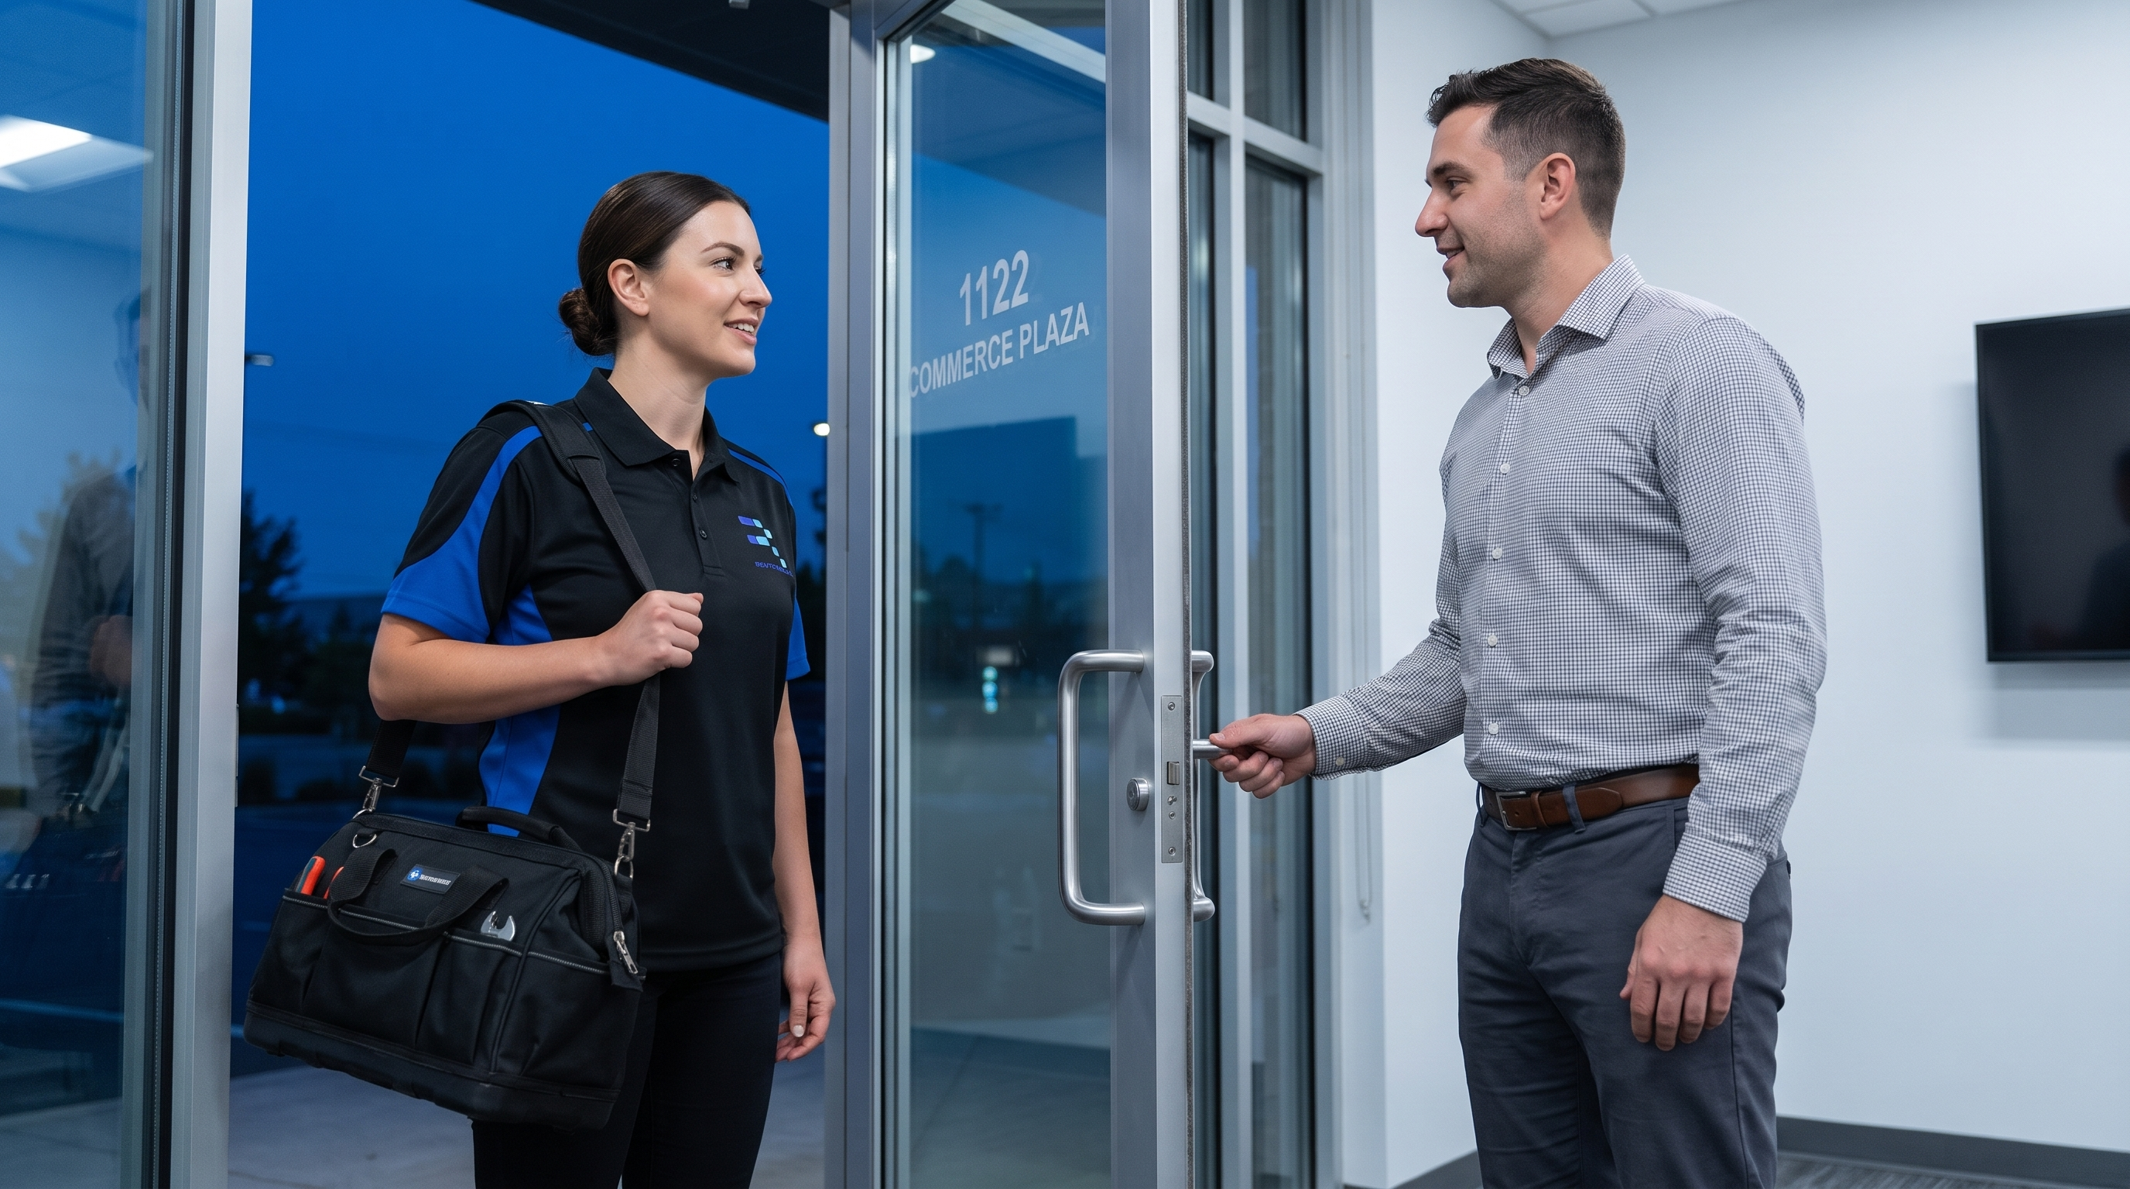
Service commitments and response planning
Planned attendance
After-hours and weekend work is available by arrangement
Response targets
Generally target next-business-day attendance. Agree response guarantees per contract
Contract-specific agreement
Confirm acknowledgement, attendance, escalation and any dedicated on-call arrangements
04
Notes:
RouterStack operational briefing, October 2026. Confirm scope, availability and service commitments per contract. Images are generated illustrations, not customer engagement photographs. Reference-guided RouterStack service illustration using supplied technician profile and uniform assets.

Slide 5
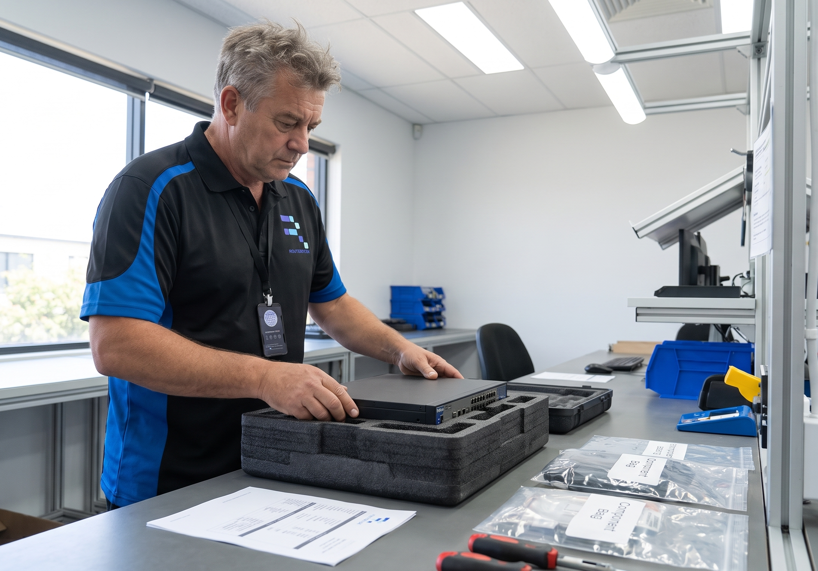
Mobilisation and technician onboarding
Existing network
Schedule against confirmed technician availability and customer access
New locations
Allow around two weeks for recruitment and onboarding, subject to local availability and required checks
Accelerated onboarding
May be possible within 24 hours when a suitable candidate and checks are ready
05
Notes:
RouterStack operational briefing, October 2026. Confirm scope, availability and service commitments per contract. Images are generated illustrations, not customer engagement photographs. Reference-guided RouterStack service illustration using supplied technician profile and uniform assets.

Slide 6

Booking and integration planning
Supported today
Portal and email intake, bulk job lists and repeat-site bookings
Planning repeat work
Dedicated automated recurring-job scheduling is not currently offered
Ticketing workflows
Native MSP ticketing integrations are not currently offered; use the agreed intake process
06
Notes:
RouterStack operational briefing, October 2026. Confirm scope, availability and service commitments per contract. Images are generated illustrations, not customer engagement photographs. Reference-guided RouterStack service illustration using supplied technician profile and uniform assets.

Slide 7

Parts, access and customer requirements
Prepare site access
Assigned technician identity and contact details support access arrangements
Arrange hardware delivery
Confirm an approved receiving address; the MSP normally ships directly
Set presentation requirements
Agree clothing, identification, aliases and any pre-engagement NDAs
07
Notes:
RouterStack operational briefing, October 2026. Confirm scope, availability and service commitments per contract. Images are generated illustrations, not customer engagement photographs. Reference-guided RouterStack service illustration using supplied technician profile and uniform assets.

Slide 8

Assurance and due diligence
Role-appropriate checks
Background checks and skills validation; additional checks where required
Insurance evidence
Request current insurance certificates and applicable policy terms during partner due diligence
Security review
Security policies and assurance documentation are available for partner due diligence
08
Notes:
RouterStack operational briefing, October 2026. Confirm scope, availability and service commitments per contract. Images are generated illustrations, not customer engagement photographs. Reference-guided RouterStack service illustration using supplied technician profile and uniform assets.

Slide 9
Agree the delivery brief before mobilisation
Locations and demand
Service commitments
Customer requirements
Site list, expected visits, work types, skills and parts
Hours, targets, escalation contacts and acceptance criteria
Access, safety, security, reporting and brand presentation
09
Notes:
RouterStack operational briefing, October 2026. Confirm scope, availability and service commitments per contract. Images are generated illustrations, not customer engagement photographs.

