Slide 1
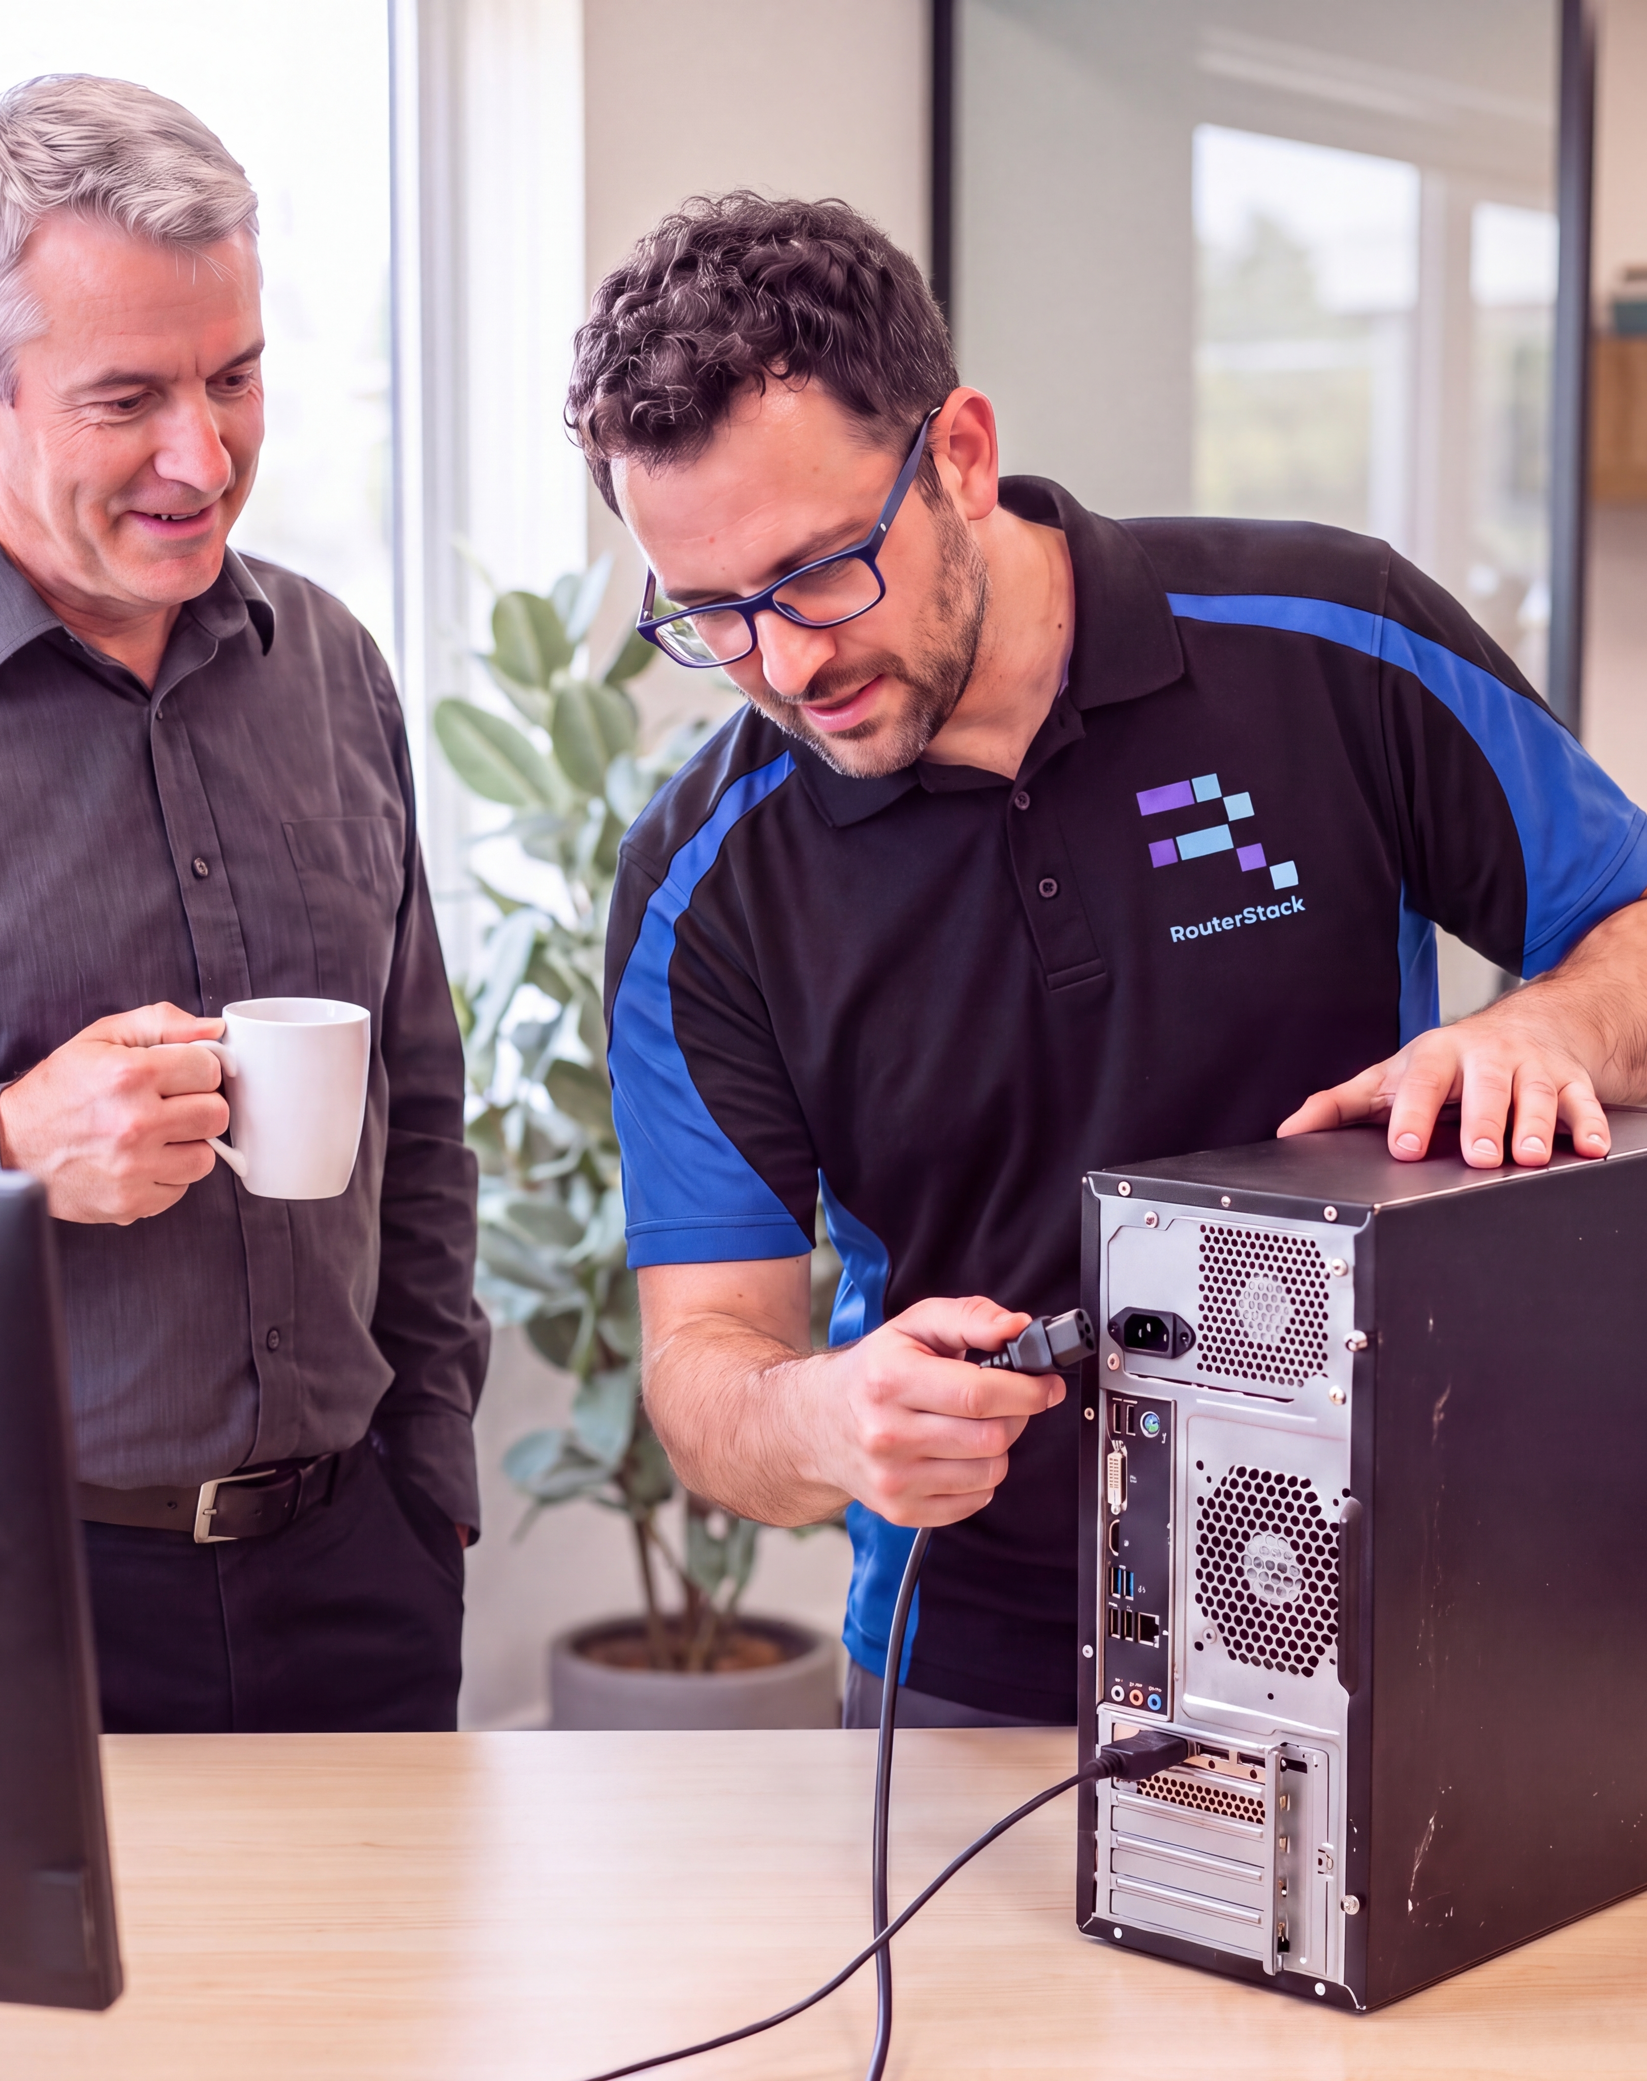

[MSP LOGO]
[MSP NAME]
ON-SITE IT SUPPORT
THROUGH ONE
SERVICE PARTNER
We’ve partnered with RouterStack to extend our on-site IT support capabilities across Australia and New Zealand
Field delivery in partnership
with RouterStack
Notes:
Customisation template for an established RouterStack partnership. Replace MSP logo and name with the presenting company identity and confirm offered scope before distribution. Image is an illustration.

Slide 2

More on-site capability through one relationship
Workplace support
Desktop setup, peripherals and deskside assistance
Networks and data centres
Device changes, smart hands and site audits
Projects and equipment lifecycle
Rollouts, equipment collection and decommissioning
Request assistance through us, without engaging another field supplier
02
Notes:
RouterStack operational briefing, October 2026. Confirm scope, availability and service commitments per contract. Images are generated illustrations, not customer engagement photographs. On-site support is an available service option; inclusion and charges depend on the customer agreement.

Slide 3
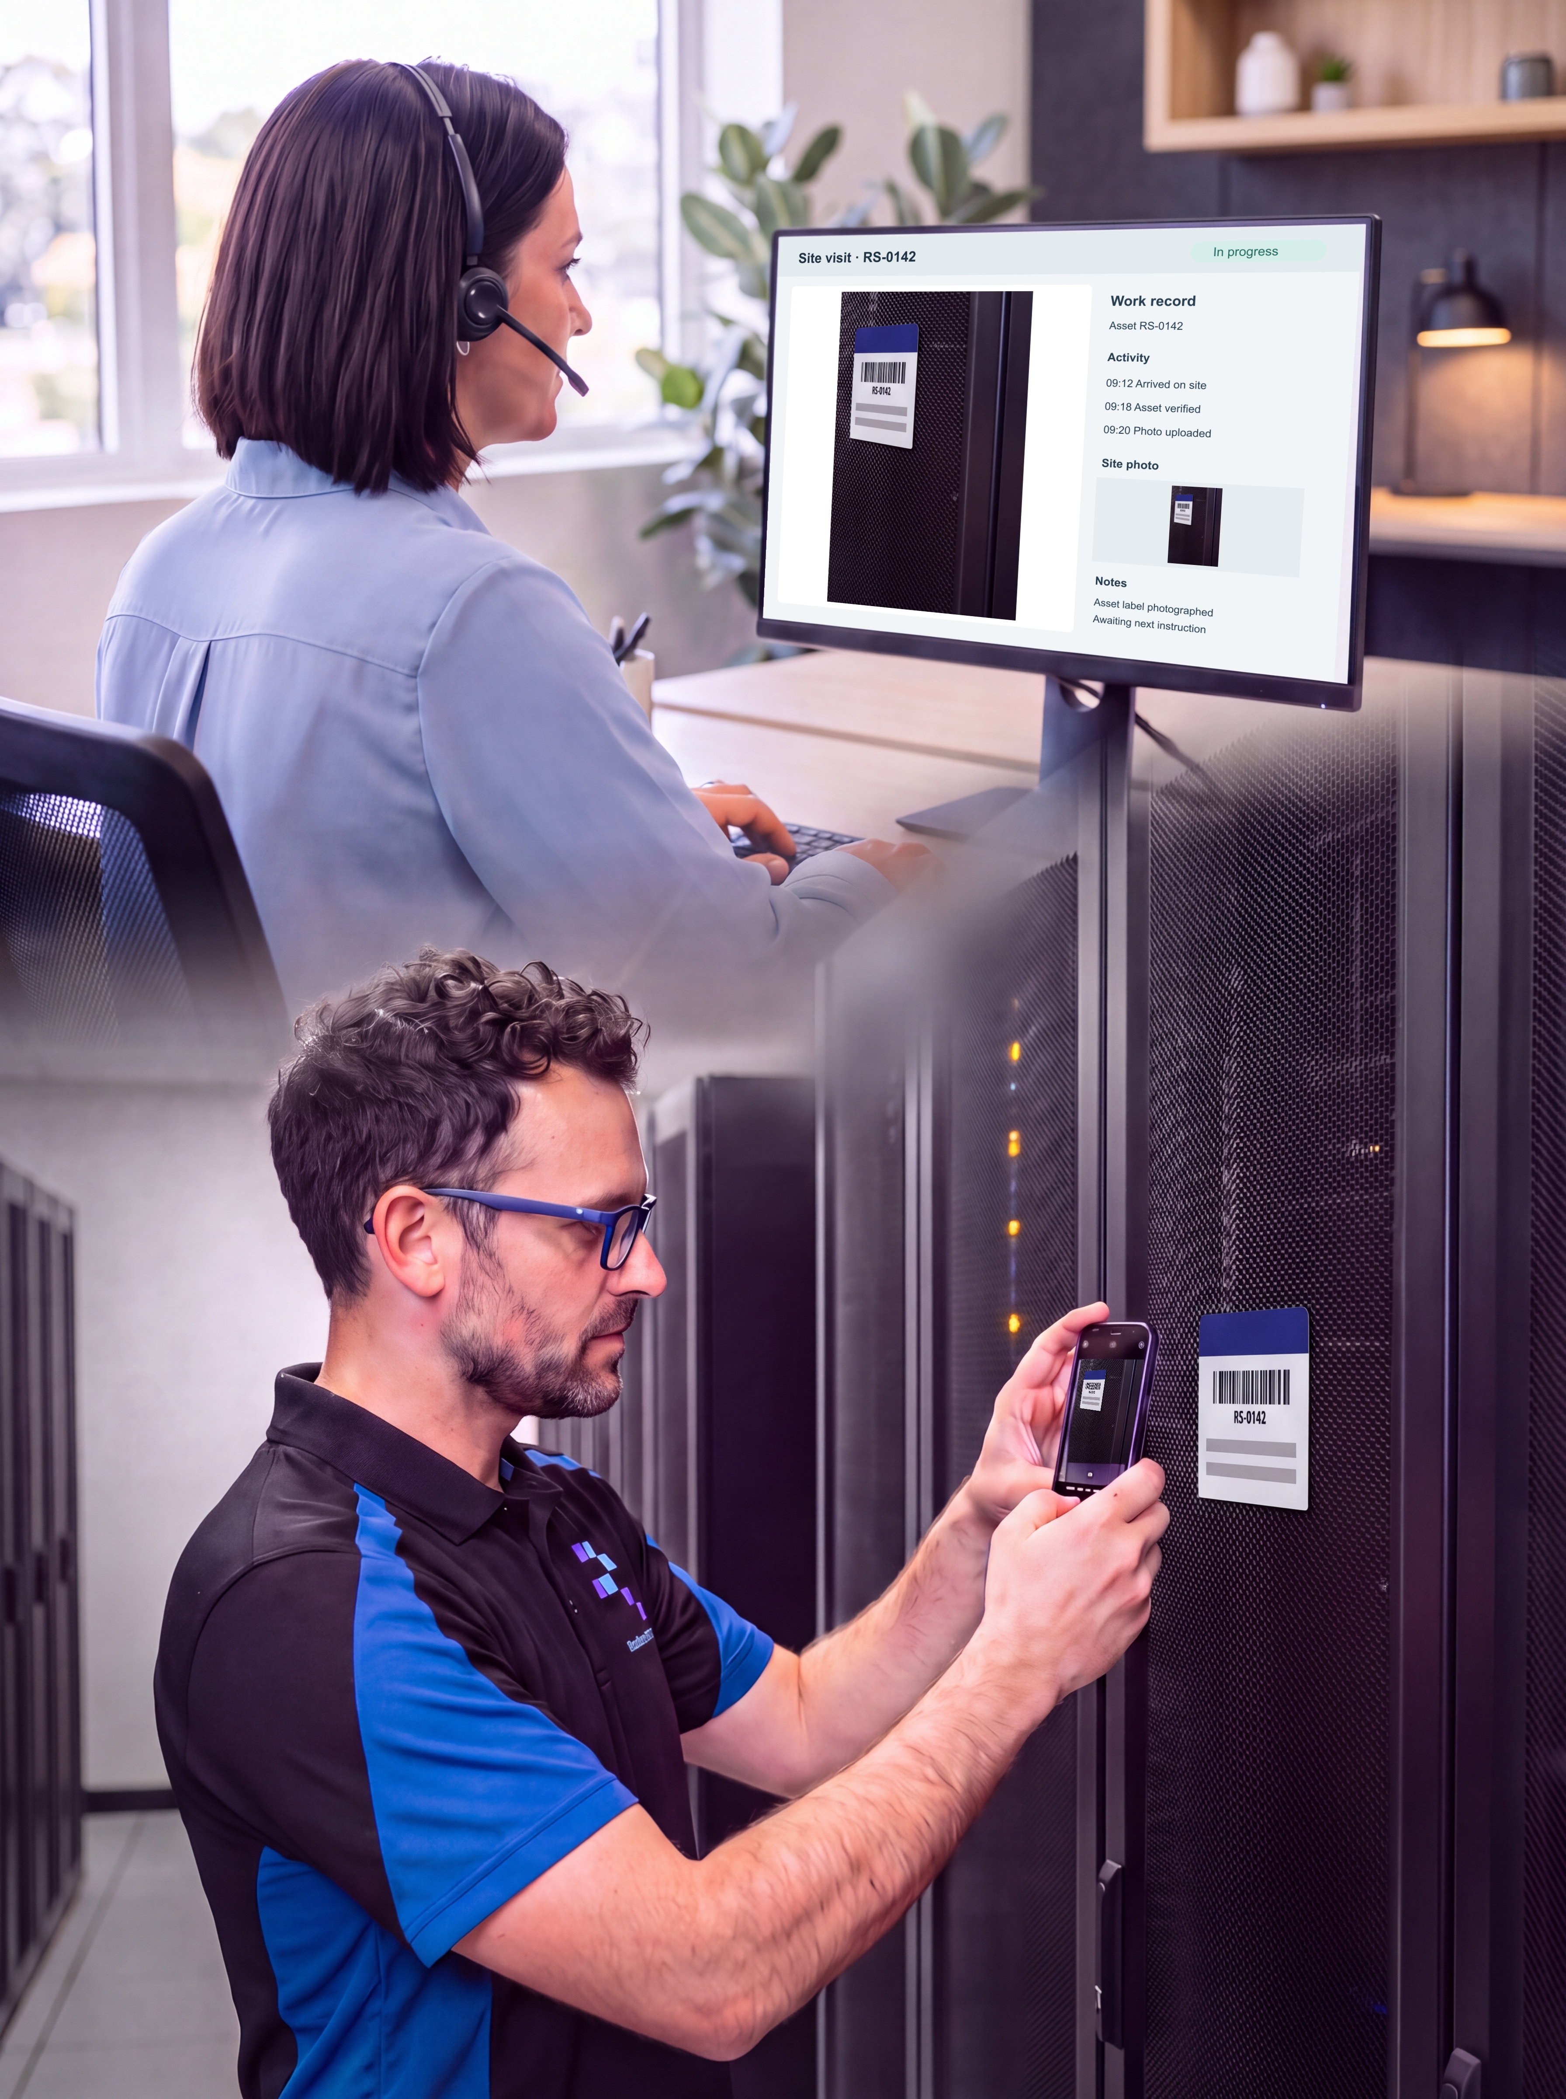
Your service team remains your primary contact
We remain responsible for your service
Our team manages technical requirements, customer communication and oversight
RouterStack coordinates attendance
Our delivery partner arranges technicians to complete the agreed on-site work
Visits fit your operating requirements
We agree access and maintenance windows around your business
03
Notes:
RouterStack operational briefing, October 2026. Confirm scope, availability and service commitments per contract. Images are generated illustrations, not customer engagement photographs. MSP retains customer communication and technical direction; RouterStack coordinates field attendance.

Slide 4
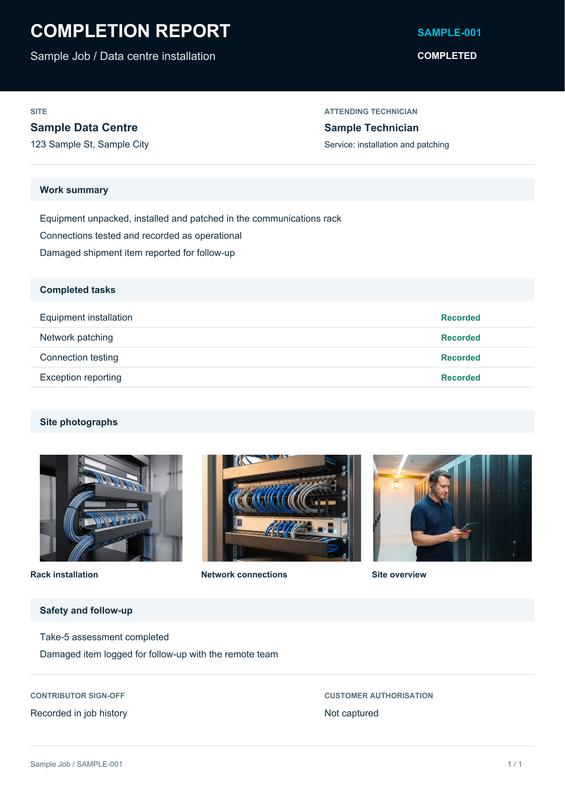
Evidence you can use
Your completed visit, documented
Task history
Completion times, notes and photographs
Site attendance
Arrival, departure and time on site
Hardware movements
Uplifted and decommissioned equipment
Materials and costs
Consumables used and recorded expenses
Safety and sign-off
Assessments, exceptions and captured sign-off
04
Notes:
Sample report with fictional job, site and technician identifiers. Work-summary themes derive from the supplied completion report: installed and patched equipment, operational connection testing, damaged item follow-up, Take-5 and contributor sign-off. Customer authorisation was not captured. The sample photographs are generated illustrative assets, not photographs from that reported visit. The layout demonstrates a complete A4 report rather than reproducing the Hub interface exactly.

Slide 5

Let’s plan your on-site support
Your requirements
Our delivery plan
Ask us about adding on-site assistance to your service plan, from a single visit to a multi-site project
[ACCOUNT MANAGER]
[MSP EMAIL] / [MSP PHONE]
Available by agreement with [MSP NAME]
05
Notes:
Replace MSP contact placeholders. On-site attendance is an available option subject to agreed scope, location, availability and terms. It is not automatically included in every support agreement. Keep the MSP as the call to action.

